Slide 1
Scientific Publishing
Dirk Riehle, Univ. Erlangen
NYT E02
Licensed under CC BY 4.0 International

Slide 2
Agenda
Research publications
Journal publications
Conference publications
The peer review process
The publishing business

Slide 3
1. Research Publications

Slide 4
Why Publish Research Papers?
I publish, therefore I am
To advance science
To have a career

Slide 5
Types and Status of Publication Types
The status hierarchy (by diligence of peer review)
Journal articles [1]
Conference papers
Workshop papers
Technical reports
In practice, there are significant quality differences between
Journals and journals
Journals and conferences
[1] In computer science, conferences may have equal standing

Slide 6
The Purposes of Academic Communication
Documentation and communication of scientific results
Early (workshop papers)
Intermediate (conference papers)
Final (journal articles)
Exchange of ideas, public conversation
Documentation of supplementary results (technical reports)

Slide 7
Academic Evaluation
Publications are a key component of academic evaluation
Researchers get evaluated for promotion (tenure)
Department rankings influence student choice
University rankings influence public funding
Beware of the bean counters
See the SF Declaration of Research Assessment (DORA) [1]
[1] See https://sfdora.org/

Slide 8
Publication Value
Publication value is measured by
Value of the publication venue
Common measure: Impact factor
Citations of publication
Common measure: Weighted counts

Slide 9
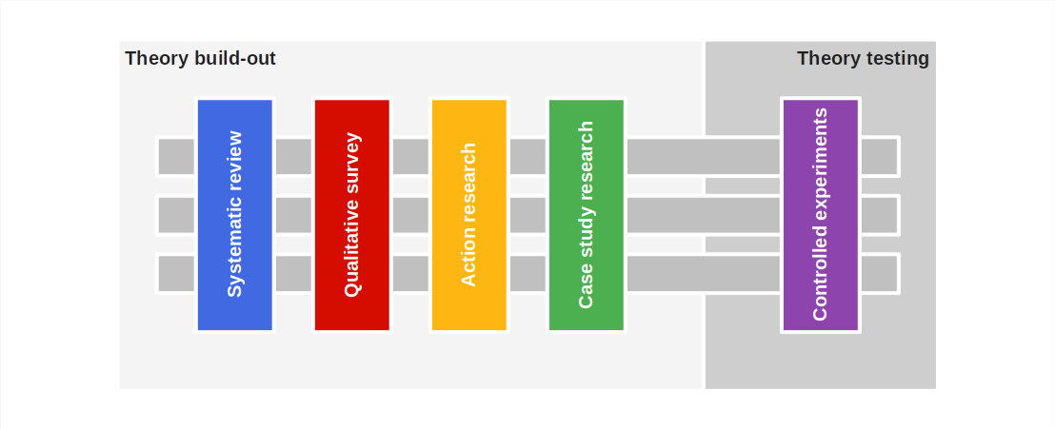
Publication Strategy

Slide 10
2. Journal Publications

Slide 11
Journal Papers
Journal papers are
Research articles accepted for
Publication in a research journal
Journals are
(Ir)regularly appearing article collections

Slide 12
Organizational Structure of a Journal
Editor-in-chief
Associated editor (a.k.a. area editor)
Reviewer

Slide 13
Software Engineering Journals
ACM Transactions on Software Engineering Methodology (ACM TOSEM)
IEEE Transactions on Software Engineering (IEEE TSE)
Empirical Software Engineering (Springer ESE)
Requirements Engineering (Springer RE Journal)

Slide 14
Journal Paper Process
No specific submission deadline (submit at any time)
Uncertain publication date (when your time has come)
Possibly multiple (re)submissions before a final decision

Slide 15
Review(er) Response Categories
Accept
Accept with minor revisions
Major revision (revise-and-resubmit)
Reject

Slide 16
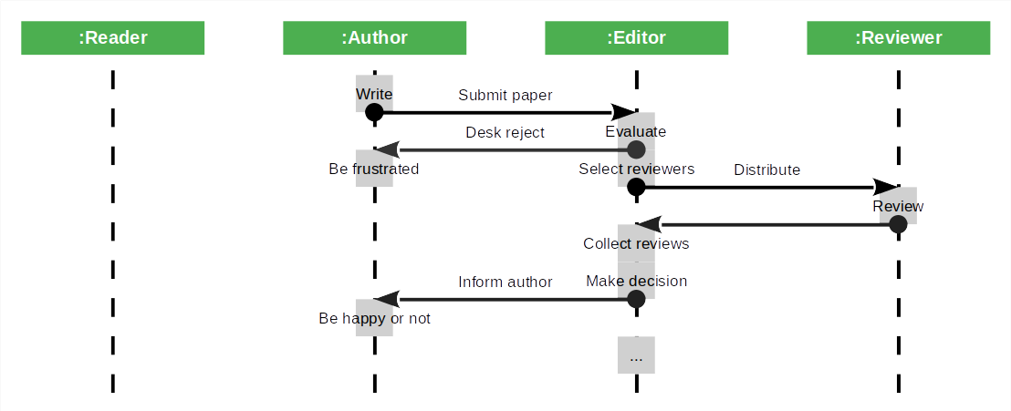
Submission and Review Process

Slide 17
Resubmission and Response to Reviewers
When faced with a revise-and-resubmit
Prepare new manuscript expediently
Write a response to reviewers

Slide 18
Example Response to Reviewers (a.k.a. Rejoinder)
Reviewer comment | Response to reviewer
1.1 In general the design of the literature review and the design of the interviews are rigorous. On the other hand, the number of interviews is rather low and the sample not representative (which is acknowledged in the manuscript). | a. We added an additional section to the limitations to mention the sample size and its influence on the guidelines and recommendations we make.
1.2 What I'm missing in the manuscript is a take-home message as well as possible ways out of the problems or challenges. The study focuses on gathering insight on the state of open collaborative data engineering (participants, roles, challenges) but I'm missing the attempt to make suggestions how to overcome the challenges. | a. We completely rewrote the discussion to add guidelines for successful open collaborative data engineering projects, based on the insights gathered in the article. b. We also added concrete recommendations to increase adoption of open collaborative data engineering in open data contexts.
1.3 I'm also missing a concise summary of the results obtained in the study. The discussion provided in Section is insufficient in this aspect. [...] | a. We combined the multiple tables for challenges into one table including all challenges to create one location that summarizes all challenges. [...]

Slide 19
3. Conference Publications

Slide 20
Conference Papers
Conference papers are
Research papers accepted for
Presentation at a conference and
Publication in the conference proceedings
Conferences are
Community gatherings where
Research work is being presented next to
Other forms of professional communication
Conference proceedings are
Research paper compendia

Slide 21
Organizational Structure of a Conference
Conference committee
Program committee (the “PC”)
Program committee chair (the “PC chair”)
Program committee members (reviewers)

Slide 22
Software Engineering Conferences
ACM Foundations of Software Engineering (FSE)
European Software Engineering Conference (ESEC)
IEEE International Conference on Software Engineering (ICSE)

Slide 23
Conference Paper Process
Most conferences take place once a year
One submission deadline for the conference
Usually single accept or reject decision
One publication date (the conference) a year

Slide 24
Program Committee Decision Process
Program chair assigns paper to multiple reviewers
Before or at the committee meeting, reviewers debate paper

Slide 25
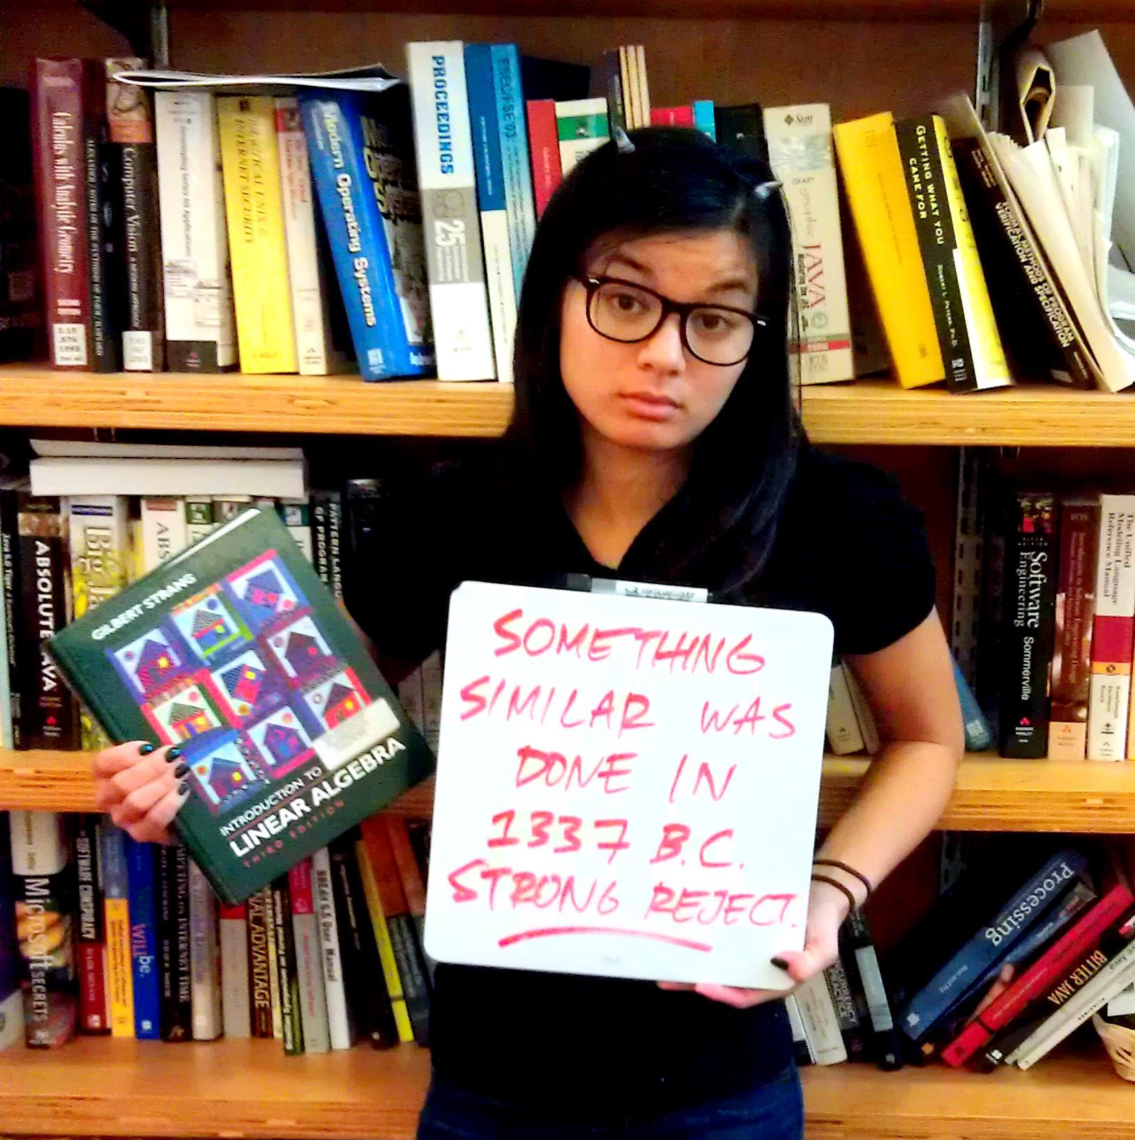
Identify the Champion Response Categories
Accept and champion
Accept but do not champion
Reject but do not detract
Reject and detract

Slide 26
4. The Peer Review Process

Slide 27

The Hallmark of Science

Slide 28
Peer Review
Peer review is
The process of providing quality assessments of scientific work by
Having other scientists provide an analysis and opinion of the work
Science’s final quality assurance measure
Evidence-based science vs. “eminence-based” science
Collaborative decision making is typically superior to an individual’s one
Applies to medicine, aircraft piloting, and science in general

Slide 29
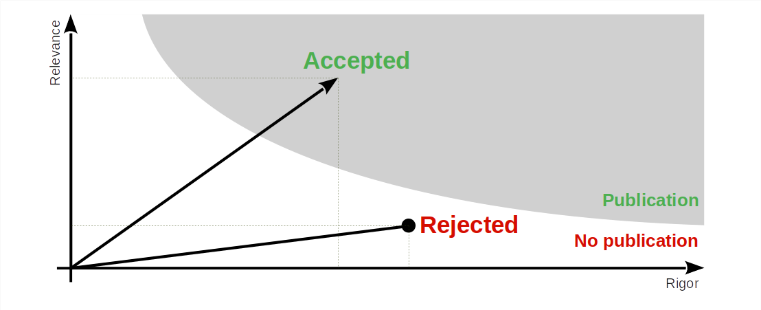
Rigor vs. Relevance (Recap)

Slide 30

Peer Review is Not Perfect (But the Best We Have)

Slide 31
5. The Publishing Business

Slide 32
Publishers
Non-profit academic publishers
ACM
IEEE (mostly)
For-profit publishers of academic research
Elsevier
Springer

Slide 33
What Publishers Do
The product
Provide access to publications
In various forms (web, paper)
Their service
Process coordination
Editing and publishing

Slide 34
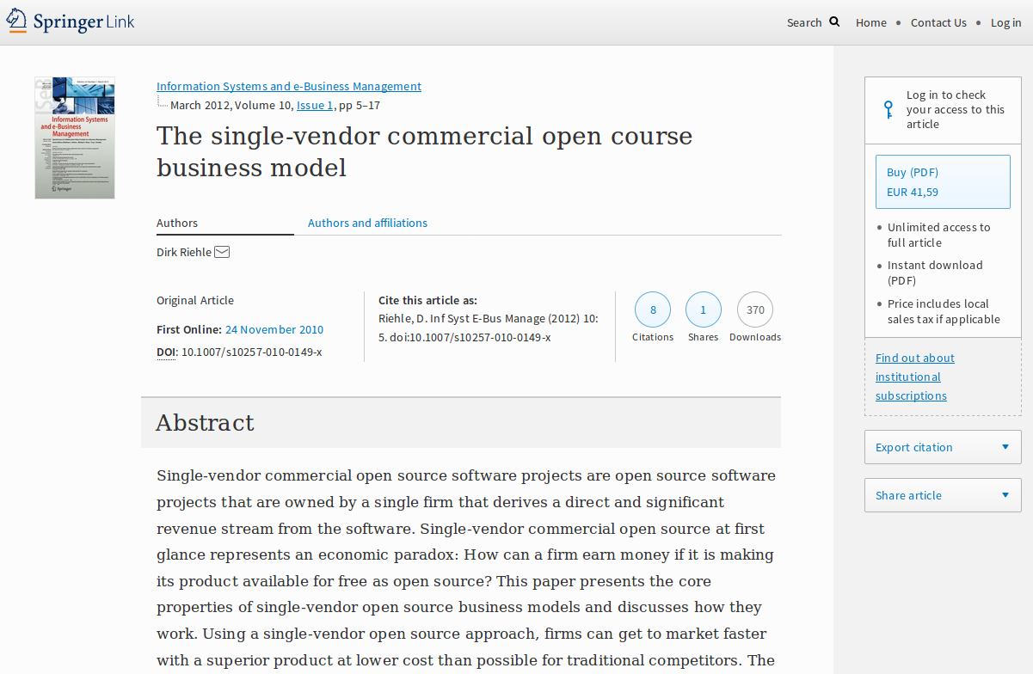
Theory vs. Practice

Slide 35
Publishing is a Business
Revenue sources are
Subscriptions to (digital) libraries
Individual article access fees
In 2022 Elsevier reported
Revenues of €3.26 billion
Profits of €1.2 billion
A profit margin of 37.8%
[1] See https://reports.relx.com/2022/esef-ar-nl/549300WSX3VBUFFJOO66-2022-12-31-nl.html

Slide 36
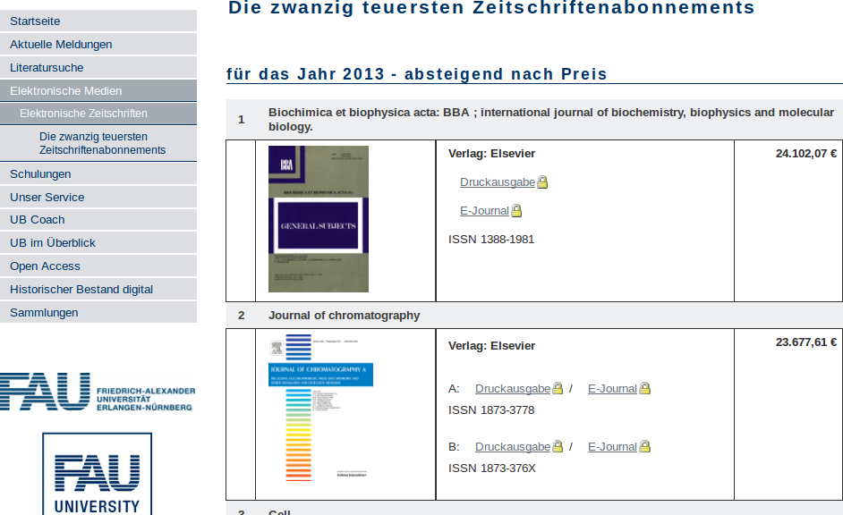
Journal Subscription Fees

Slide 37
Three Eras of Publishing
First era (mostly gone, but not fully)
Authors paid publishing fees, subscribers paid subscription fees
Second era (until recently, still going on)
Authors do not pay anything, subscribers pay subscription fees
New open access era (expanding)
Authors pay publication fees, access to article is free

Slide 38
Open Access
Open access is
The free and unencumbered access to a research article
Golden open access
The authors pay a publisher to provide the article for free
Green open access
The authors provide the article for free while the publisher charges a fee

Slide 39
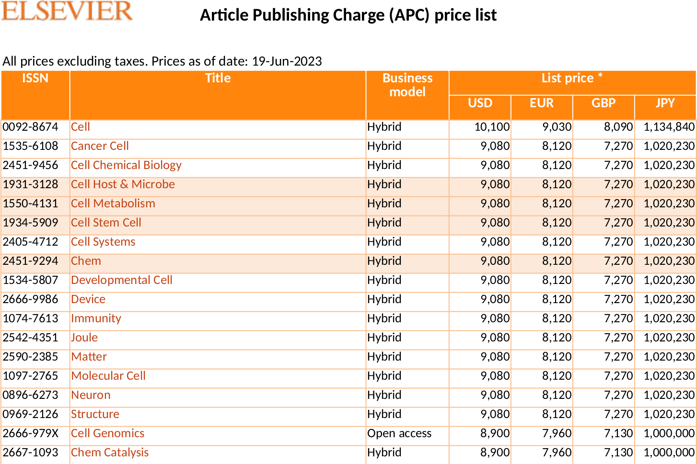
Elsevier (Open Access) Article Publishing Charge [1]
[1] See https://www.elsevier.com/about/policies/pricing

Slide 40
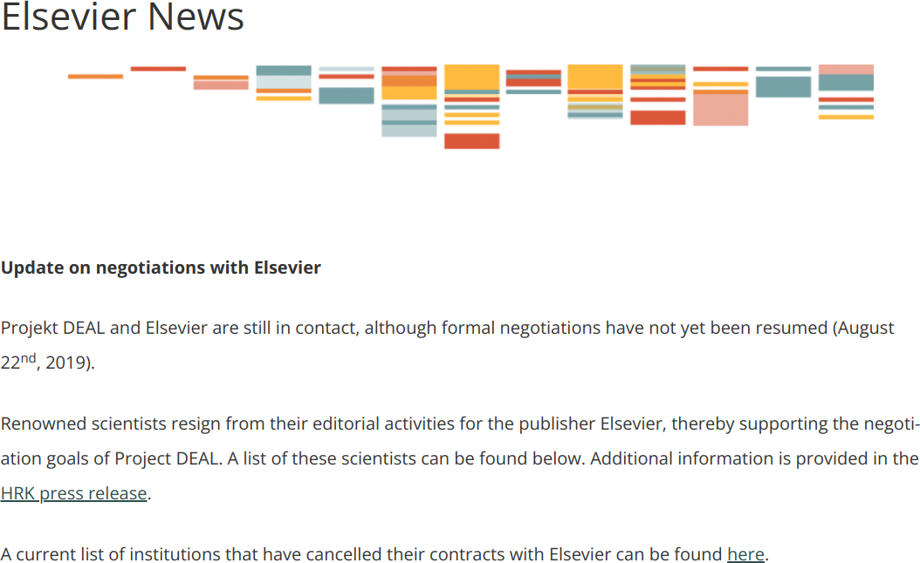
Elsevier Was Holding Research Results Hostage [1]
[1] See https://www.projekt-deal.de/elsevier-news/

Slide 41
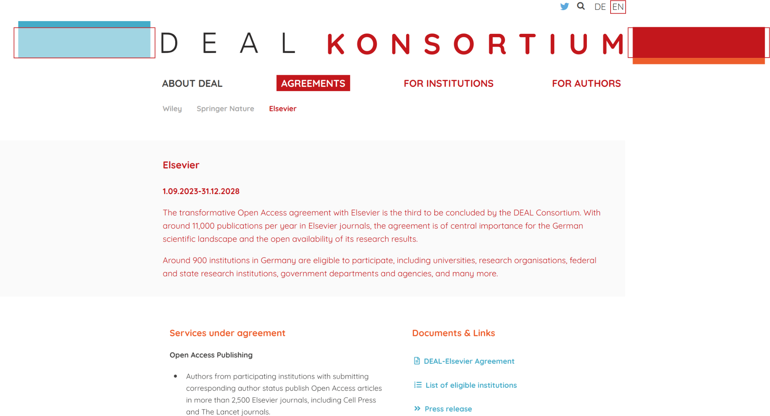
Until An Expensive Agreement Was Reached in 2023

Slide 42
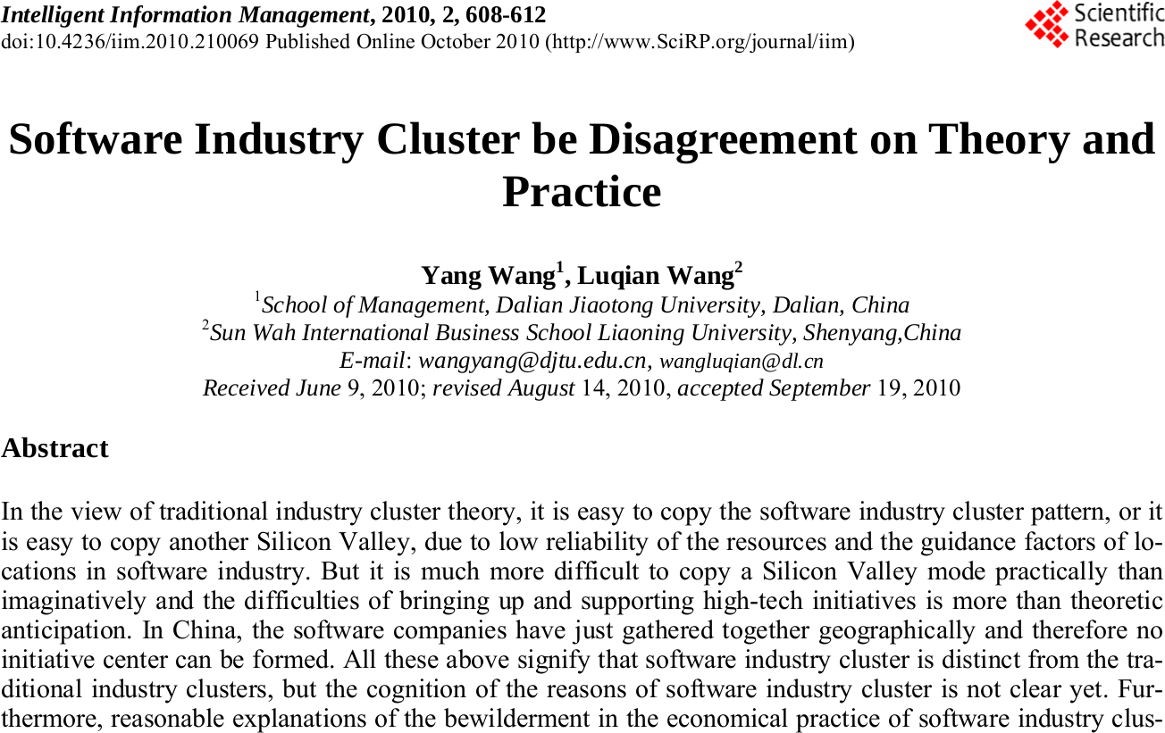
The Rise of Predatory Publishers

Slide 43
Thank you! Any questions?
dirk.riehle@fau.de – https://oss.cs.fau.de
dirk@riehle.org – https://dirkriehle.com – @dirkriehle

Slide 44
Legal Notices
License
Licensed under the CC BY 4.0 International license
Copyright
© 2012, 2023, 2024 Dirk Riehle, some rights reserved

